Slide 1


Title : Café with online ordering (UI)
Café with Online Ordering: "Brew & Bean" café wants a site where users can build their coffee order. Use form elements (checkboxes for add-ons, number for quantity) and dynamically update the order summary and total price using JavaScript (conceptually, focus on the form UI).

Slide 2
Basic Structure of HTML
<html> <head> <title>Brew & Bean Café</title> </head> <body>
🔹 <html>
Root element of the webpage.
🔹 <head>
Contains information about the webpage (not visible on screen).
🔹 <title>
Sets the tab name in the browser → Brew & Bean Café
🔹 <body>
Contains all visible content (what user sees).

Slide 3
🔘 Radio Button Example
<input type="radio" name="coffee" value="espresso">
🔹 <input type="radio“>
Allows user to select only ONE option
🔹 name="coffee"
Groups all radio buttons together
Only one can be selected from same name
🔹 value="espresso"
Value sent when form is submitted
➕ Add-ons (Checkboxes)
<input type="checkbox" name="addon" value="milk">
🔹 <input type="checkbox">
Allows selecting multiple options
🔹 Difference:
✅ Radio → only one
✅ Checkbox → many options

Slide 4
☕ Choose a coffee (Espresso, Latte, Cappuccino) ➕ Select extra add-ons (Milk, Caramel, Cream) 🔢 Enter quantity 👤 Fill personal details (Name, Phone) 📩 Submit the order
Main Concept of This Code :
To create a simple online coffee ordering form for a café (Brew & Bean Café)

Slide 5
Future Improvements for this project :
1. Add CSS (Design & Styling)
Make the page look modern and attractive
Add colors, fonts, spacing
Style buttons and inputs
Create a café theme ☕
Example improvements:
Background color or image
Stylish buttons
Better layout (centered form)

Slide 6
Code:
<html>
<head>
<title>Brew & Bean Café</title>
</head>
<body bgcolor="brown">
<h1>Brew & Bean Café ☕</h1>
<form>
<h3>Select Your Coffee</h3>
<input type="radio" name="coffee" value="espresso">
<img src="https://upload.wikimedia.org/wikipedia/commons/4/45/A_small_cup_of_coffee.JPG" width="80">
Espresso (Rs30)<br><br>

Slide 7
<input type="radio" name="coffee" value="latte">
<img src="https://www.seriouseats.com/thmb/mhyOZEerd4xc6CwJVoRJ-rgg44o=/1500x0/filters:no_upscale():max_bytes(150000):strip_icc()/__opt__aboutcom__coeus__resources__content_migration__serious_eats__drinks.seriouseats.com__images__2013__11__20131107-latte-tulip-464c68d355e34ac1870c1230dd93e7ee.jpg" width="80">
Latte (Rs40)<br><br>
<input type="radio" name="coffee" value="cappuccino">
<img src="https://cdn.uengage.io/uploads/18085/image-993178-1717589323.jpeg" width="80">
Cappuccino (Rs50)<br><br>
<h3>Add-ons</h3>

Slide 8
<input type="checkbox" value="milk"> Milk (+Rs100)<br>
<input type="checkbox" value="caramel"> Caramel (+Rs150)<br>
<input type="checkbox" value="cream"> Whipped Cream (+Rs200)<br>
<h3>Quantity</h3>
<input type="number" name="quantity" min="1" value="1">
<h3>Your Details</h3>
Name: <input type="text" name="name"><br><br>
Phone: <input type="text" name="phone"><br><br>
<br>
<input type="submit" value="Place Order">
</form>
</body>
</html>

Slide 9
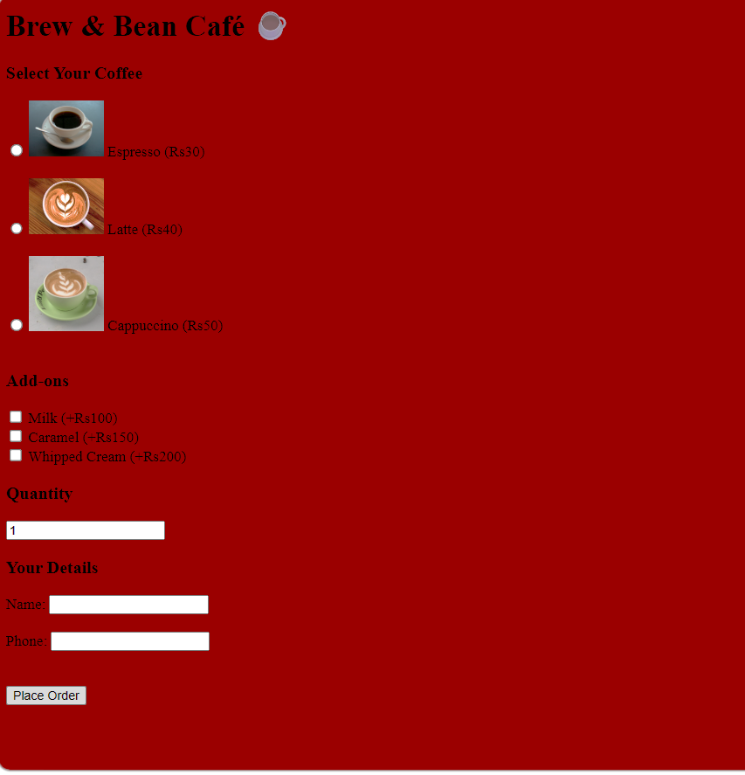

Slide 10
Conclusion
This HTML code successfully creates a simple and user-friendly café ordering form using basic form elements.
It demonstrates how to:
Collect user input using different input types (radio, checkbox, text, number)
Organize data in a structured way using a <form>
Build a basic interface for an online ordering system
Thank you,
USN :CS25019
Module 1

